Slide 2
Continuing Medical Education Financial Disclosure
Amedco, our CME provider, asks that all individuals who have the ability to influence and/or control the content of this accredited activity disclose any/all relationships with ‎Ineligible Companies.
This information is disclosed to CME activity participants, and Amedco has procedures in place to resolve any apparent conflicts. In addition, presenters are asked to disclose when any discussion of unapproved use of pharmaceuticals and devices are being discussed.​
In the past 24 months, I (Charles Benight, Margaret Morison, Bernard Ricca, Carlos Torres), have not had financial relationships with any ineligible companies. ​

Slide 3
Mass Trauma Resilience Open Science Data Sharing Solutions Technology
Secure Open Science Resilience Data Sharing System (SOS-RDSS)
Charles C. Benight, PhD
Mimi Morison, MA, PhD Student
Bernard Ricca, PhD
Carlos E. Torres, PhD in Computer Science Student

Slide 4
Funding and Grant Team
This project is funded through NSF # (FAIN): 2115134
Project Title: CICI: UCSS: ACSP4HR: Assuring Cyber Security and Privacy for Human Resilience Research: Requirements, Framework, Architecture, Mechanisms and Prototype
Principal Investigator: Shouhuai Xu (sxu@uccs.edu)
Co-Principal Investigator: Charles C Benight (cbenight@uccs.edu)
Co-Principal Investigator: Yanyan Zhuang (yzhuang@uccs.edu)

Slide 5
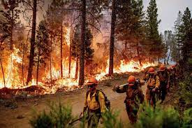
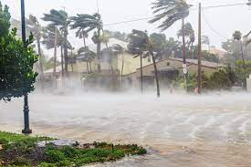
Mass Trauma Science: The Challenge
Studying the psychological resilience and distress associated with Mass Trauma events is often difficult.
Challenges with coordination among researchers.
Difficult with timing of entering the field making some questions (acute responses) hard to answer.
Data sharing from these events is virtually non-existent.

Slide 6
This project aims to provide a competent technical solution to modernizing and accelerating the scientific discovery process for Human Resilience research, by tackling a range of technical challenges
Specifying the requirements of a competent cyberinfrastructure.
Defining a solution framework to adequately address these requirements.
Designing a comprehensive system architecture to fulfill the framework.
Investigating novel mechanisms and supporting techniques.
Developing a prototype system and demonstrating its usefulness.

Slide 7
This SPDS System will:
Be a secure and privacy-preserving data sharing web system for data science computations toward the scientific community that has limited data sharing opportunities.
The system provides secure authentication for users (for integrity) and a workflow for permission management to access datasets.
This allows users to request access and dataset owners to grant or reject it, placing the control of the datasets in their hands.
This system is a web and cloud-based system, fully open-source, and available for self-hosting upon completion.

Slide 8
Overview of Today’s Workshop Flow
Mimi Morison will discuss the role of psychological science in this project in relation to standard statistical approaches.
Dr. Barney Ricca will talk about the utilization of R in creating a system that can run data without the user having access to the raw data.
Carlos Torres will present the secure/private data sharing system and demonstrate the key elements of how data sharing is done.

Slide 9

Initial Progress
Translation between psychology & computer science
Normative expectations for statistical analysis in psychology
Create/score variables
Reliability of measurement
Assess assumptions for analysis
Outline researcher decision points
Notes:
Decision point examples:
- variables added in steps (i.e., hierarchical models)
- options for checking multicollinearity, normality, internal consistency & acceptability of different levels

Slide 10
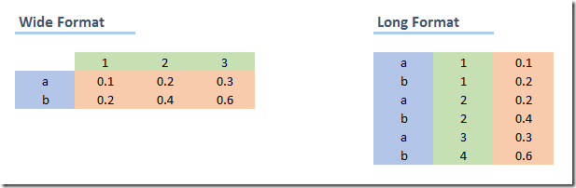




Psychological Data
Notes:
Long data vs. Wide data
Missing data
Merged files & participant IDs – all things “data cleaning”
Date format

Slide 11

Submitting Data
Data must be checked:
Malicious code
Corresponds to original IRB
Satisfies privacy requirements (e.g., GDPR)
Transparently cleaned & annotated
No wrangling done by us
Attest to pre-processing
Need a process by which we can see the data to determine the above!
Currently done ad hoc

Slide 12
Submitting Analyses
Anyone can contribute analyses!
Currently, all analyses are submitted in R or Python
Free
Relatively large bases of users
Corresponds to expertise working on the project
Submission Constraints
Reduce reliance on humans
Make as useful as possible to all
Maintain privacy
Approved and Implemented

Slide 13
Example: Linear Regression
Consider the “simple” univariate linear regression
Can we all agree on the proper process? (Kummerfeld & Jones, 2023)
And this is even before the differences between statisticians and psychology journals
Outliers and how to handle outliers
Post hocs
Yes? No?
Report the results
APA (and everyone else’s) formatting requirements
Standardized v. non-standardized coefficients?
Confidence intervals

Slide 14
Example: Linear Regression
Write the script to submit
Need some level of coding sophistication
Need incredibly good comments
System Administrator
Transparency to other users

Slide 15
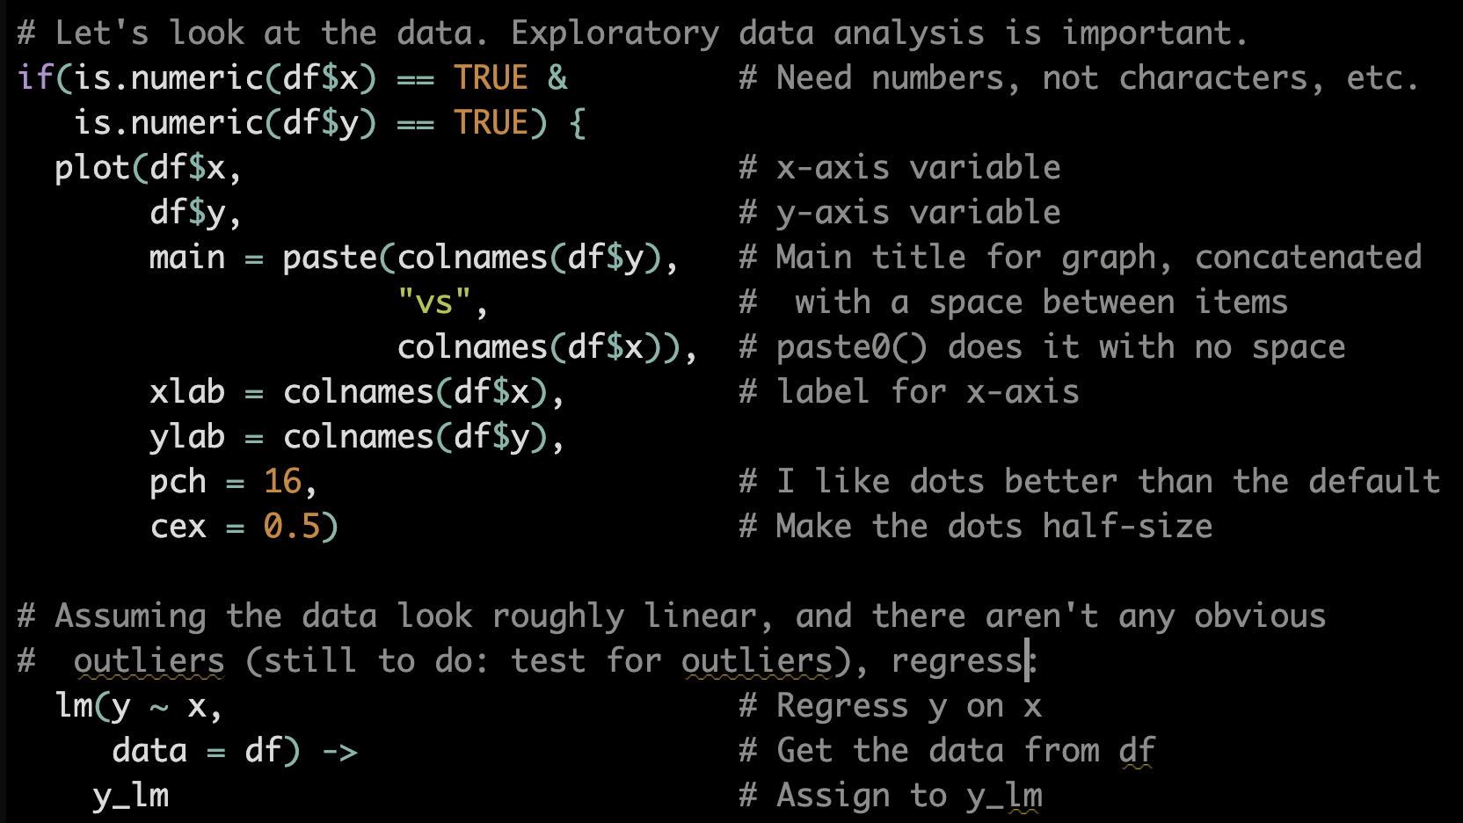
Example: Linear Regression

Slide 16

SPDS
Secure and Privacy-Preserving Data Sharing
for Data Science Computations

Slide 17
Introduction
Scientific research communities often need to share datasets.
Often these datasets contain private information.
Datasets are just not shared, or they are stripped down of information.
Additionally, it would be good to be able to have access to analyses without compromising data privacy
A system to share data securely and privately would be great!

Slide 18




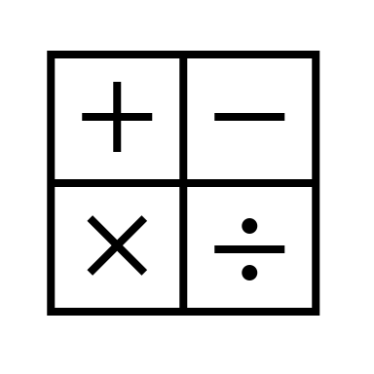


Usage Scenario
Publish
Get access directly
Dataset
Access
Metadata
Alice
Request
Access
Bob
Grant
Access
Run
Computations
View
Results

Slide 19
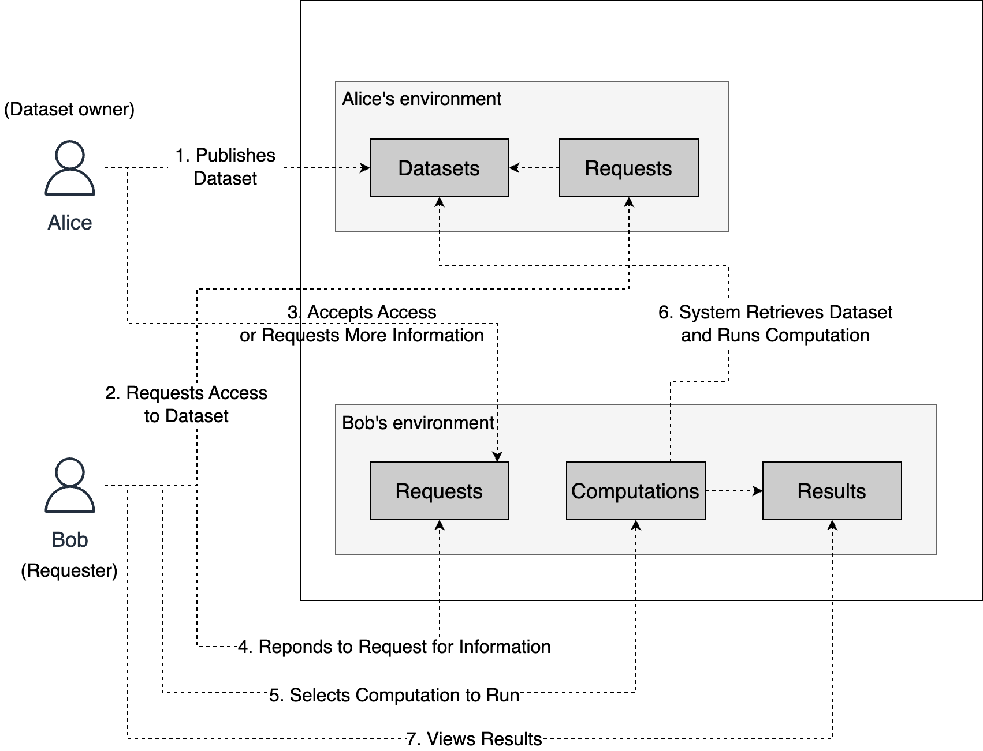
Usage Scenario

Slide 20
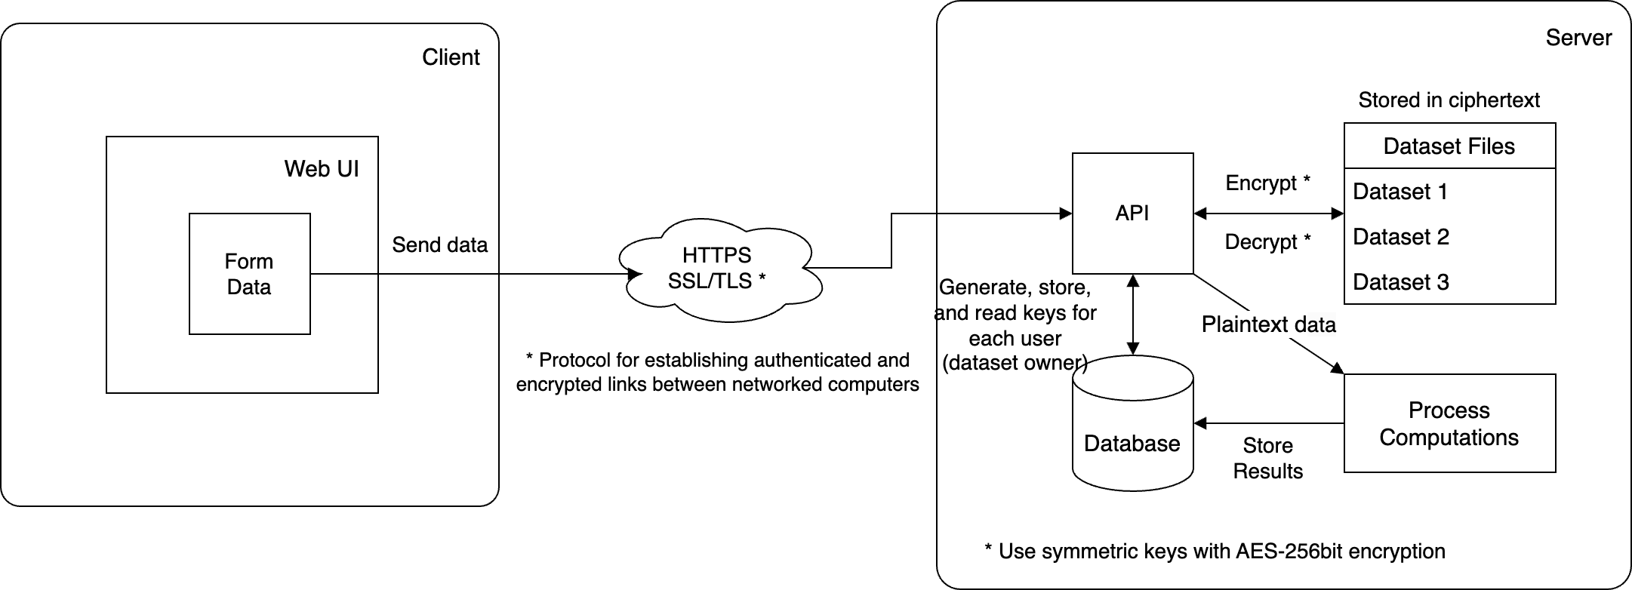
System Architecture

Slide 21
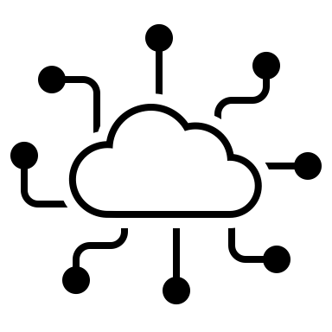

SPDS
Secure data-sharing and private-preserving system
Data is actually not shared, just computations run
Fully open-source and web/cloud based
SPDS

Slide 22
Main Functionalities
Secure dataset publishing and storing
Stored fully encrypted
Browse and search datasets metadata
Add favorite datasets
Workflow for dataset access requests
Request dataset access
Approval or denial of access
Computations to run on the datasets
Run computations on datasets that have access
Computations to choose, based on data analysis systems
Results of computations, in form of lists or graphs
Users can send new suggestions of computations to be added

Slide 23
Security and Privacy Highlights
State-of-the-art encryption to store the datasets
Data never shared, only metadata
Dataset access permission workflow
Computations curated by system admin to avoid data leaks
Users cannot add new computations, just send suggestions
Secure access to the system via user authentication
Passwords stored as hashes
Logs of usage for all user actions in the system
Open source computations code available

Slide 24
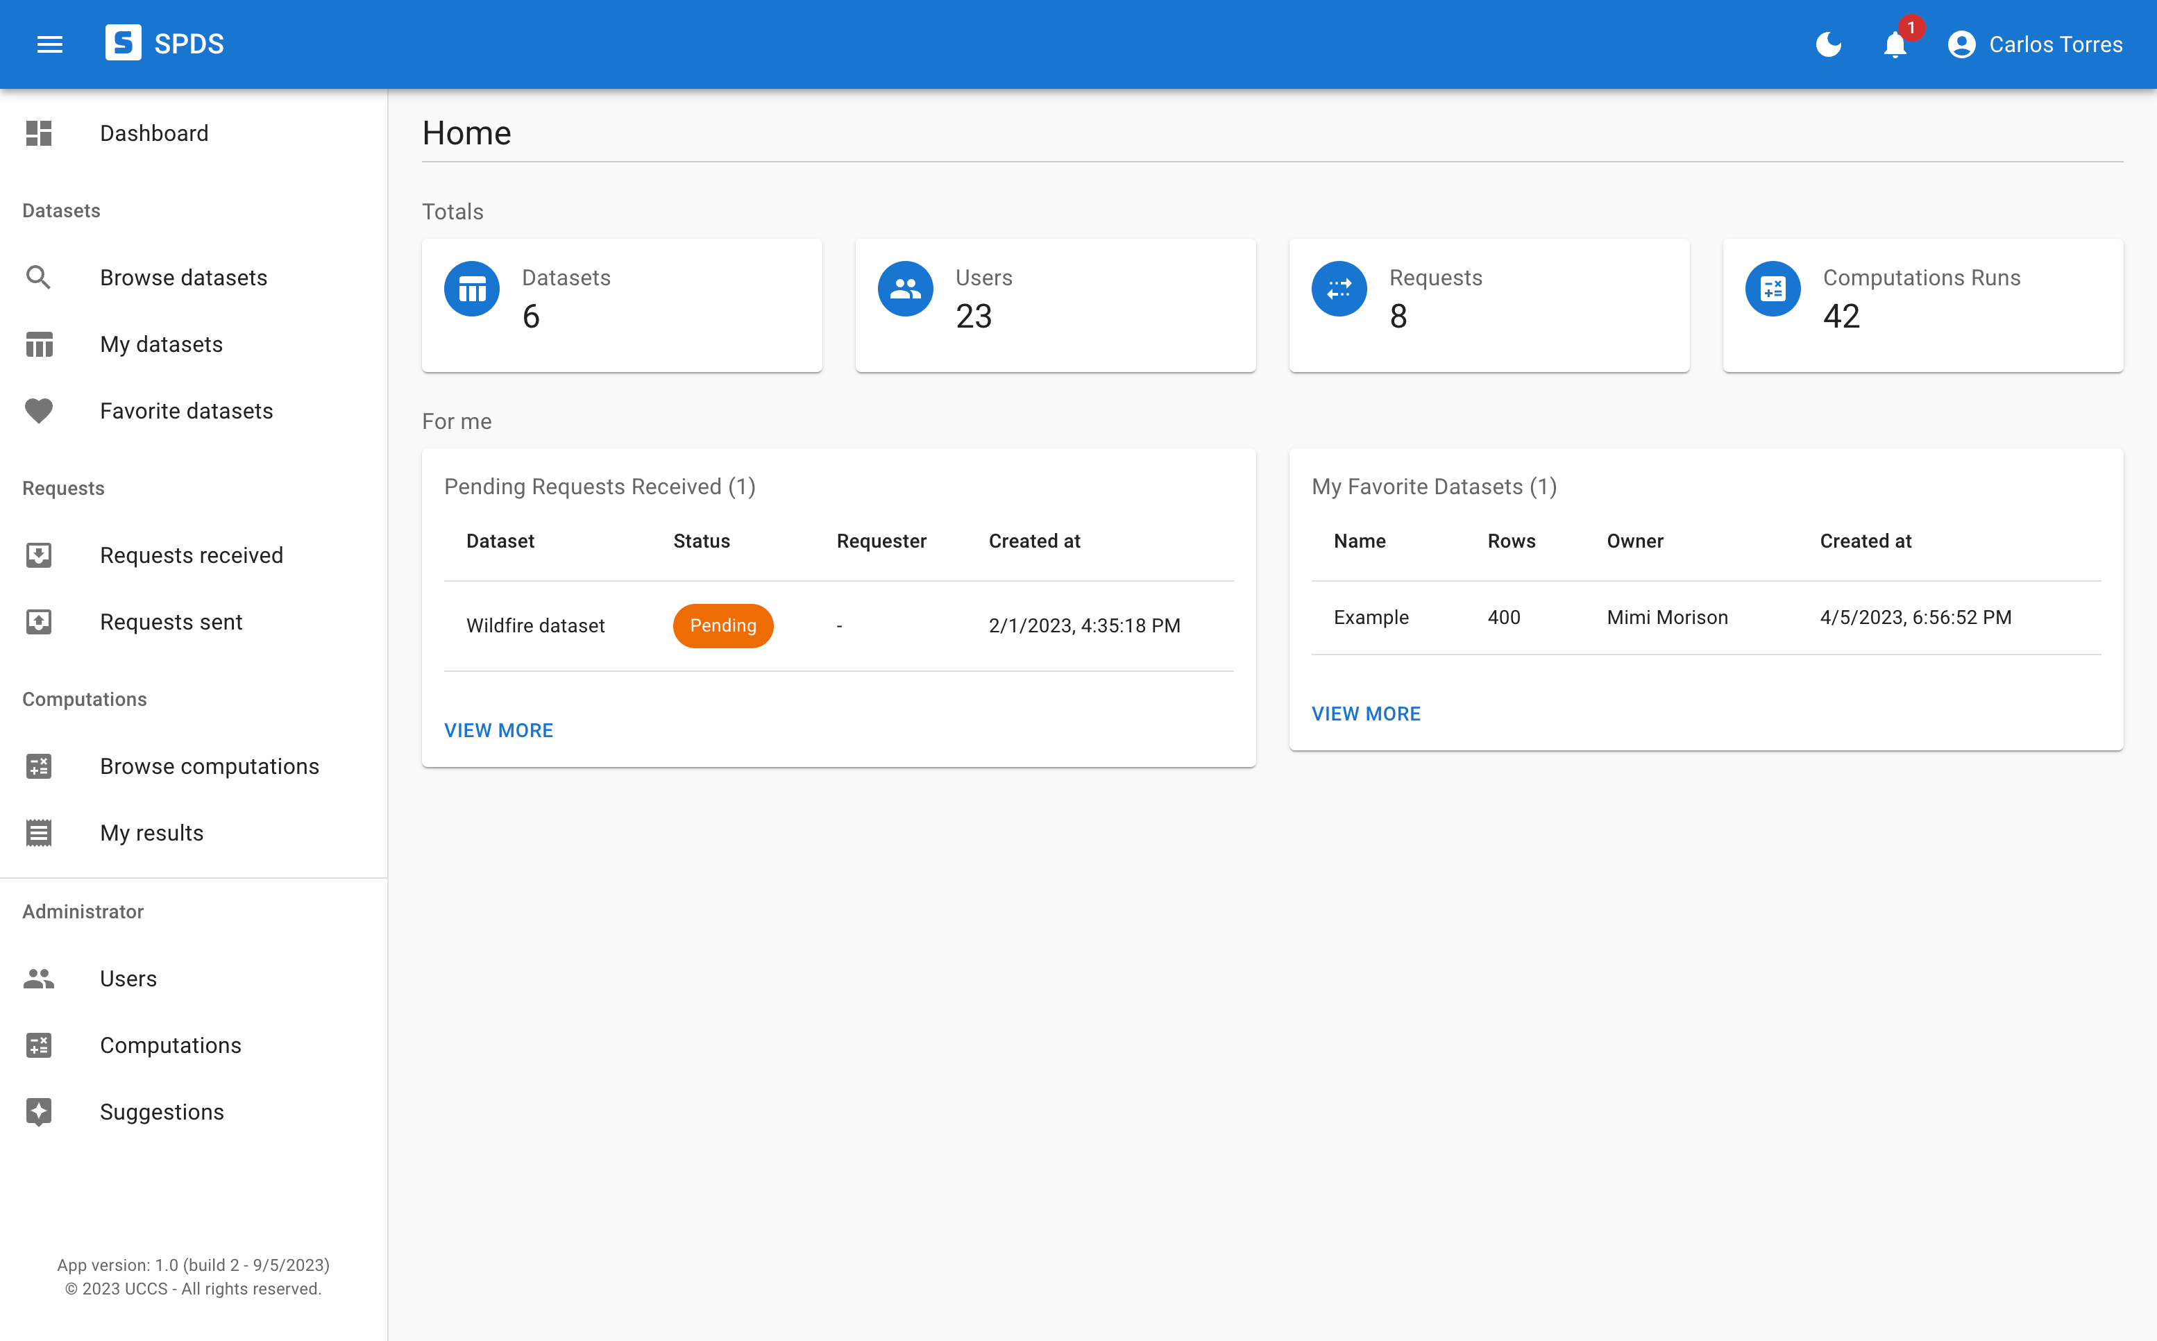
Demo
https://acsp4hr.tk

Slide 25
Contacts
Charles C. Benight (cbenight@uccs.edu)
Mimi Morison (mmorison@uccs.edu)
Bernard Ricca (bricca@uccs.edu)
Carlos E. Torres (carlos.torres@uccs.edu)

Slide 26

Questions?

